Slide 1
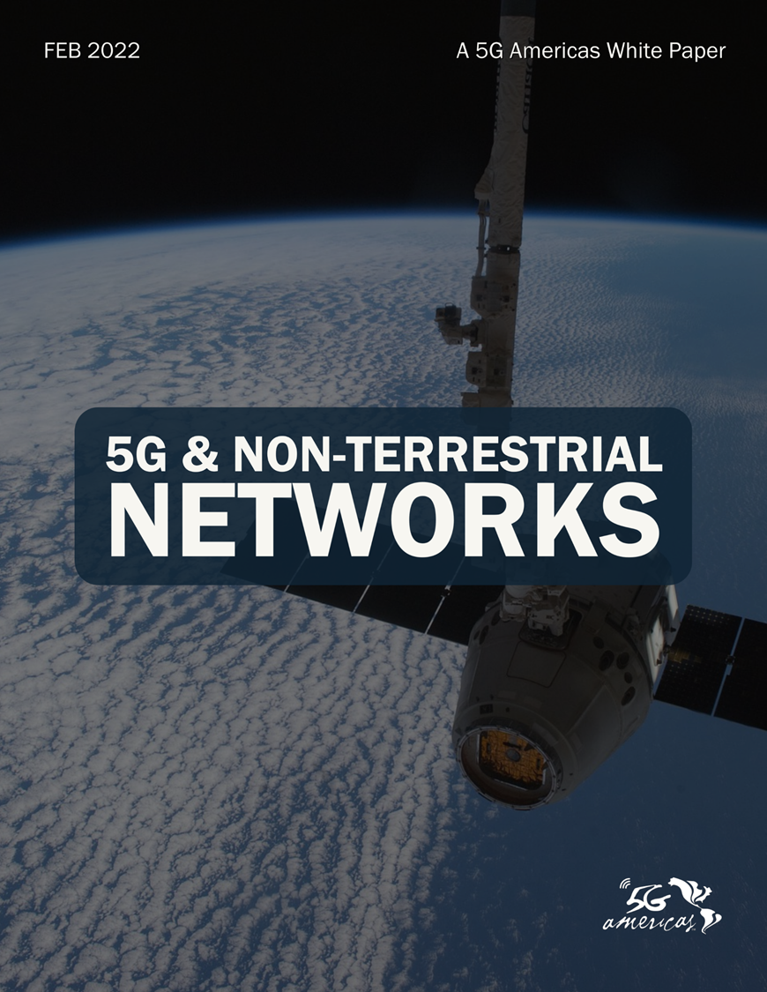
Presentation Slides Permission to use with attribution to ‘5G Americas’ is granted

Slide 2


“New use cases become possible when 5G’s unique capabilities expand to more inaccessible regions with the help of non-terrestrial networks. Operators face interesting opportunities and challenges as new 5G standards pave the way towards increasing integration between terrestrial and non-terrestrial networks.”
Chris Pearson, President, 5G Americas

Slide 3
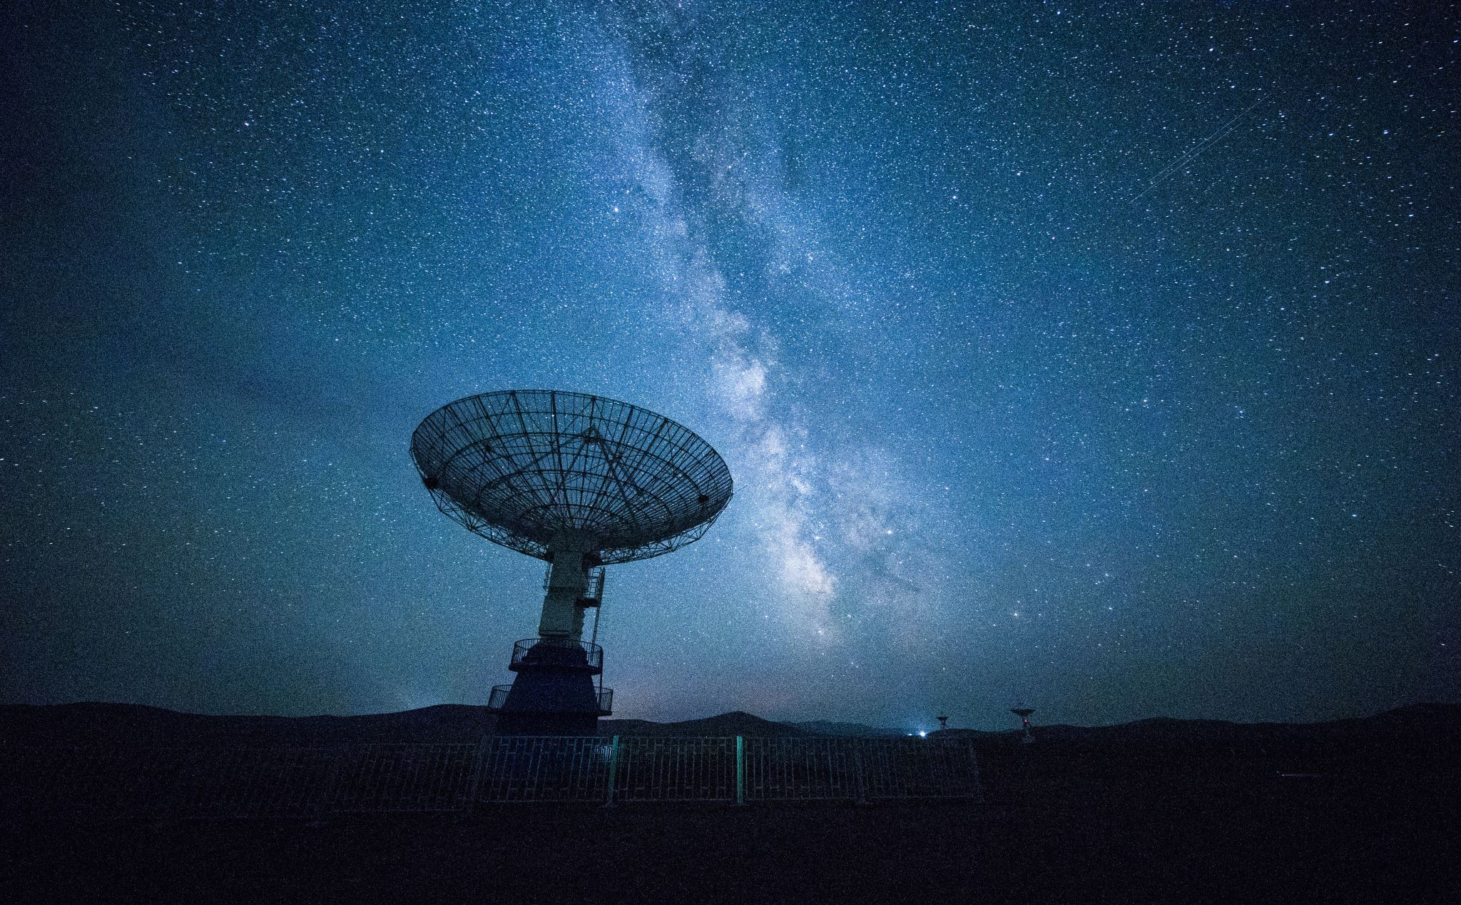

“Integration and co-existence of satellite and terrestrial systems has become important as we move beyond 5G and will require increased standardization and collaboration between the satellite and telecom industry. This will benefit both satellite and mobile operators by enabling new services, additional access availability and providing remote and rural areas with increased connectivity. There have been good advances made with 3GPP Rel-17 and there is much more to be addressed for co-existence as these integrated systems get deployed.”
Sridhar Rajagopal
SVP & Sr. Fellow, Technology & Strategy, Mavenir and 5G Americas working group leader

Slide 4

“3GPP Release 17 will introduce new network topologies into the 3GPP specifications that include high-altitude platforms and Low Earth Orbit and geosynchronous orbit satellites. New constellations of satellite deployments and work at 3GPP have provided a possible pathway for closer integration of terrestrial and non-terrestrial networks.””
Rahul Pal
Principal Engineer, T-Mobile and 5G Americas working group leader

Slide 5
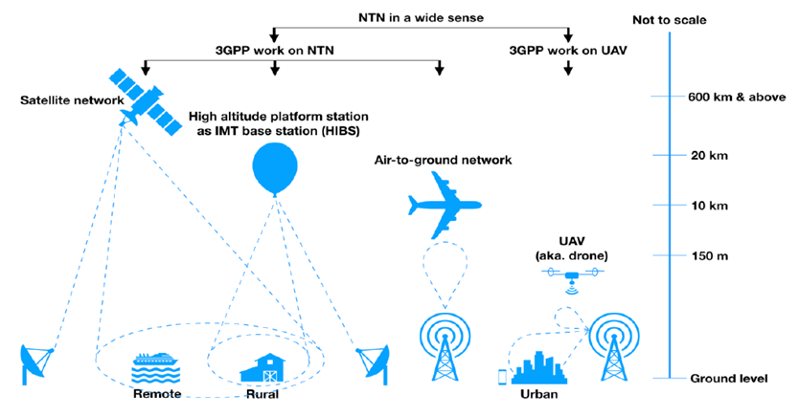

Different types of non-terrestrial networks

Slide 6
Satellite NTN typical scenario based on transparent payload

Slide 7
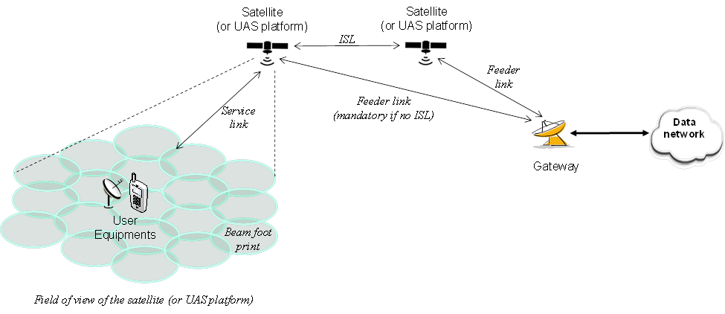
Satellite-based NTN typical scenario based on regenerative payload

Slide 8
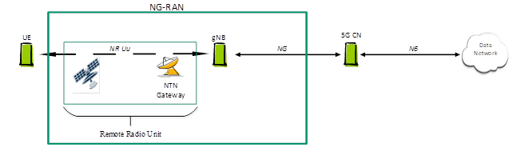
Networking-RAN architecture with transparent satellite

Slide 9
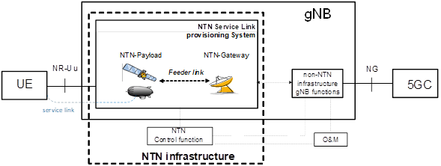
Satellite payload + feeder link + GW + Non-NTN infrastructure gNB

Slide 10
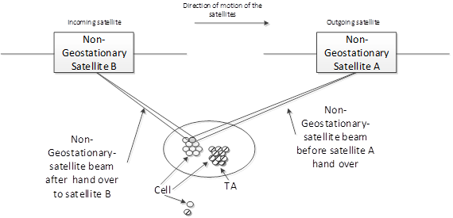
Non-Geostationary Satellite Beam steering and Handover

Slide 11
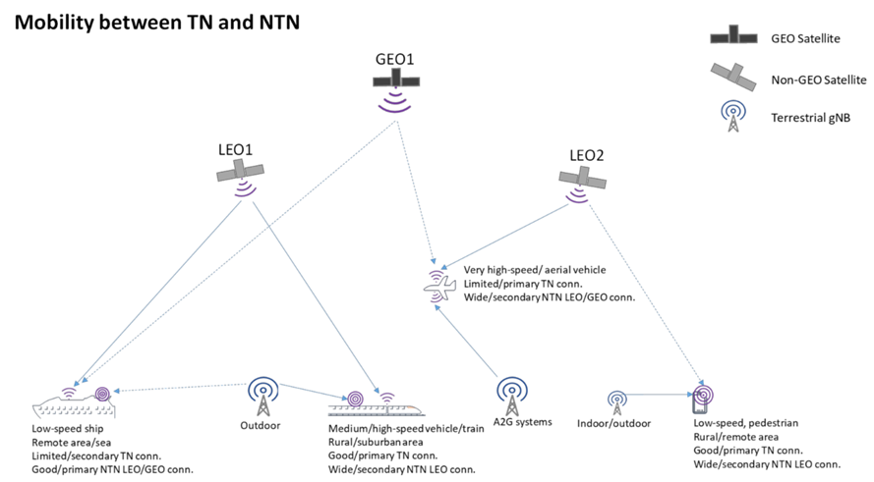
Typical example of NTN-TN interworking

Slide 12
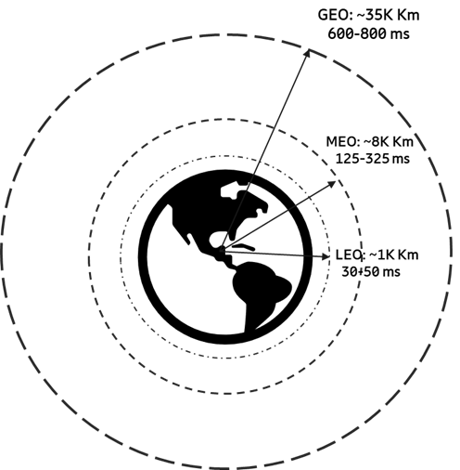
LEO, MEO and GEO satellite altitudes and latencies

Slide 13
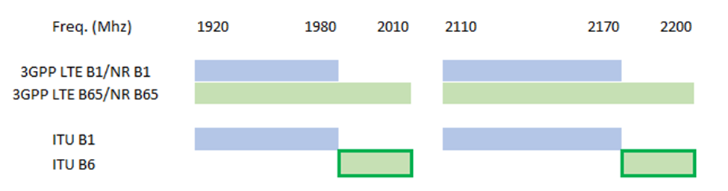
3GPP-identified frequencies for use by satellites in NTN’s

Slide 14
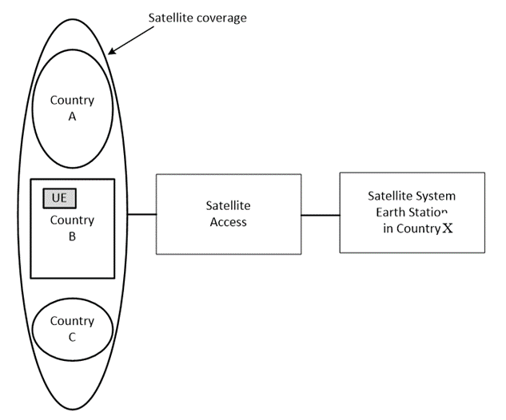
Satellite access with satellite beams overlapping several countries

Slide 15
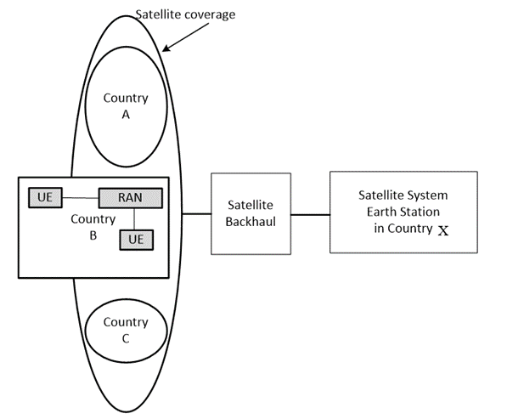
Satellite access with satellite beams overlapping several countries

