Slide 1



Presentation Slides
Permission to use with attribution to ‘5G Americas’ is granted

Slide 2


The work done by 3GPP in Release 17 improved 5G New Radio (NR) by adding support for new services, reduced-capability user equipment, non-terrestrial networks, frequency bands beyond 52GHz, and the multicast and broadcast service (MBS).
He further added, “The next few years will see initial work on Release18, the 5G-Advanced standard, which will offer a boost to network performance and create even more opportunities.”
Chris Pearson, President, 5G Americas

Slide 3
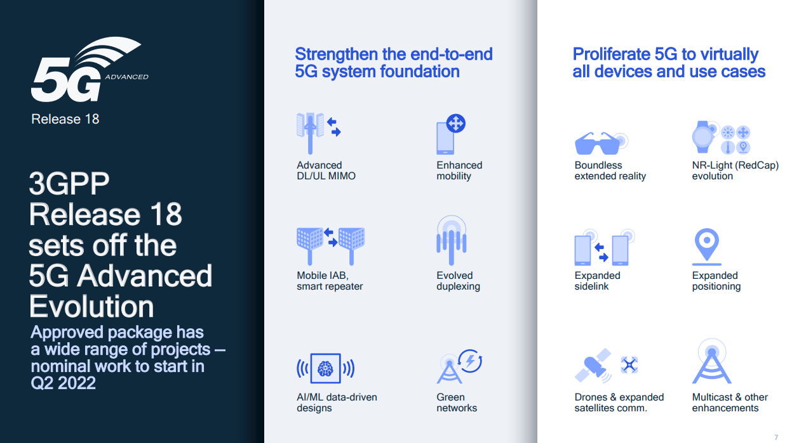

3GPP Rel-18 sets off the 5G Advanced Evolution.
Source: Qualcomm, Jan 2022.

Slide 4
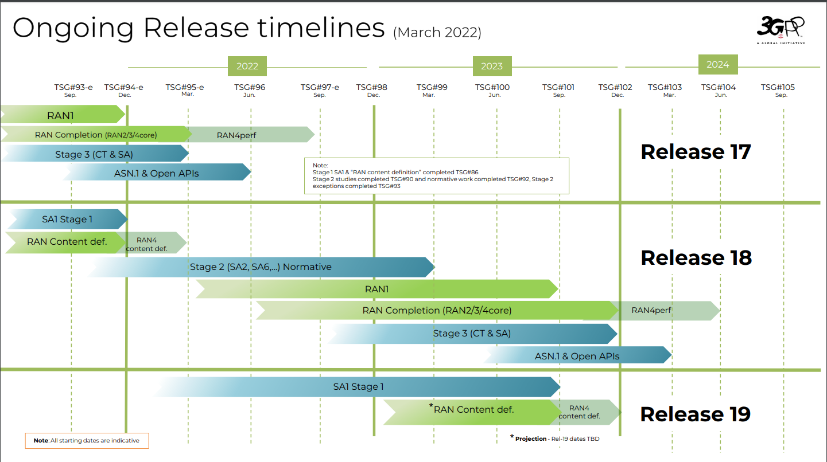

Slide 5
Illustration of the concept of SBFD comparing with FDD/TDD

Slide 6
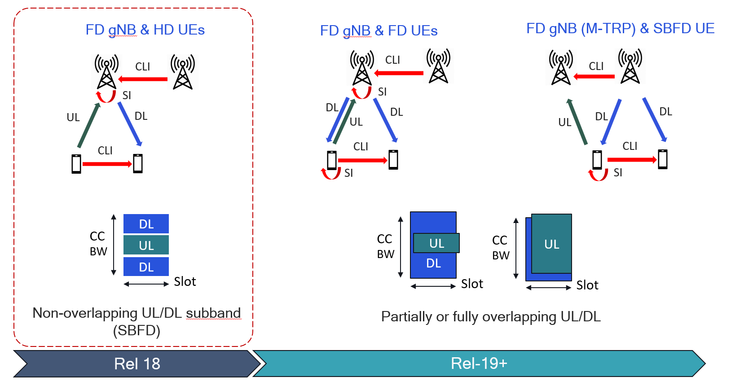
Road map to evolution of full duplex technologies

Slide 7
Scenarios for UE-to-Network Relay

Slide 8
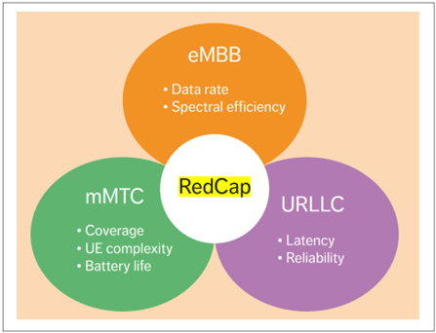
Release 17 RedCap targets the requirement space between eMBB, URLLC and mMTC

Slide 9
Requirements of wearables, industrial wireless sensors, and video surveillance use cases
 | Data rate | Latency | Availability/ reliability | Battery lifetime | Device size
Wearables | 5-50Mbps DL, 2-5 Mbps UL | Relaxed | N/A | up to 1-2 weeks | Compact form factor
Industrial wireless sensors | < 2Mbps | <100ms | 99.99% | At least a few years | N/A
Video surveillance | 2-4 Mbps for economic video, 7.5-25 Mbps for high-end video | <500ms | 99% - 99.9% | N/A | N/A

Slide 10
Comparison of device capabilities
 | R15/16 NR eMBB | R17 NR RedCap | R18 NR RedCap (Expected) | LTE-M (Cat M1) | NB-IoT (Cat NB1)
UE BW | 100MHz (FR1), 200MHz (FR2) | 20MHz (FR1), 100MHz (FR2) | 20MHz or 5MHz (FR1 only) | 1.4 MHz | 180 KHz
Duplex | FD-FDD, TDD | FD/HD-FDD, TDD | FD/HD-FDD, TDD | FD/HD-FDD, TDD | HD-FDD, TDD
UE Antenna | 1T2R(FDD)/1T4R(TDD) | 1T1R/1T2R | 1T1R/1T2R | 1T1R | 1T1R
Max Modulation Order | 256QAM for DL, 64QAM for UL | 64QAM (256QAM optional) | 64QAM (256QAM optional) | 16QAM | QPSK
Peak Data Rate – DL | 2.3 Gbps | 220Mbps | 10 Mbps | 588 kbps | 26 Kbps
Peak Data Rate – UL | 468 Mbps | 120Mbps | 10 Mbps | 1119 kbps | 66 Kbps

Slide 11
Self-scheduling, cross-carrier scheduling, and multi-cell scheduling

Slide 12
